Slide 1

Large Format - Architectural, Custom 3D, Wayfinding, ISM, Window Graphics, Traffic Solutions, Hoarding…
Creating reality from YOUR Vision!

Slide 2

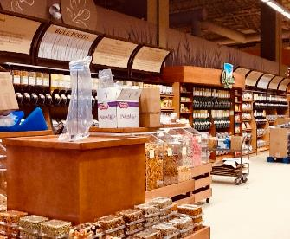

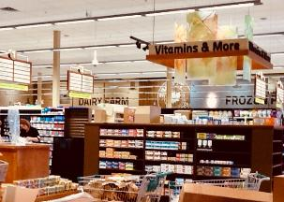
Multi-faceted Projects
DÉCOR PACKAGES
Custom, Powder Coated Metal “curved” frames
3D Lettering
Aisle Markers (suspended)
Bulkhead Lettering
Large Format Wall Graphics

Slide 3
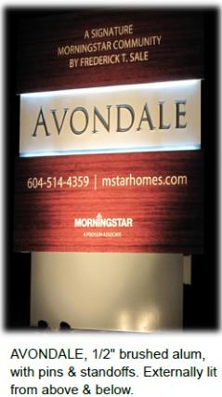

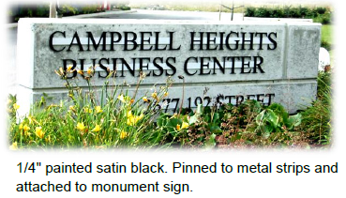
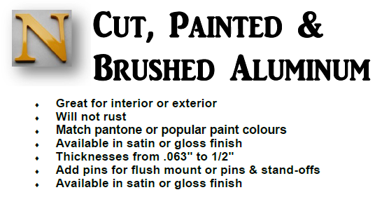
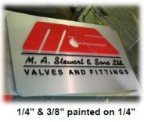
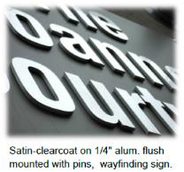
Notes:
AVAILABLE IN SATIN OR GLOSS FINISHES – YOU ALSO HAVE IT LISTED TWICE!!!!

Slide 4

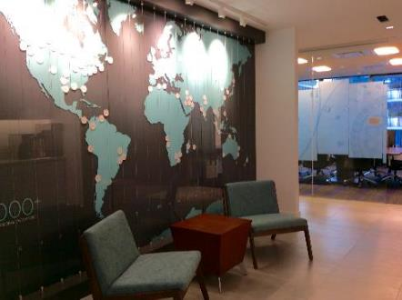
25 Story High Rise
Vancouver, BC
25 Story Building
Multiple custom components
Glass graphics
3D effects
Custom build items
Code requirements

Slide 5

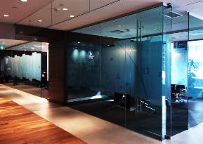
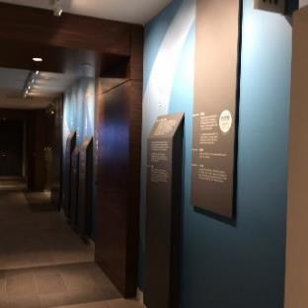
25 Story
High Rise
Vancouver, BC
3D Lettering
Custom Printed Graphics
Raised, Wrapped & Printed Panels
Custom Designed Wall Graphics
Printed Echmark (frost) Glass Graphics

Slide 6

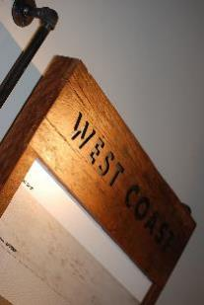
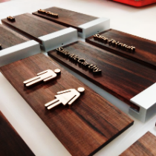
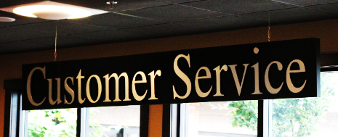
The Warmth
of Wood
Custom Wood Signs
Raised Wooden Symbols & Letters
3D Lettering
Every application; wall mount, custom framing system, suspended, etc.

Slide 7


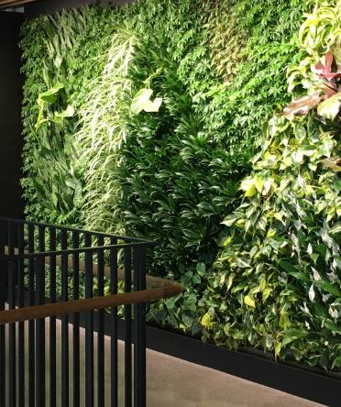

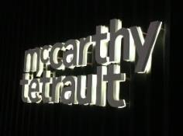
Specialty Signage
Lighting it up.
Custom Cut, Warm-Ivory Halo Lit Letters
Rare “look” with warmer undertones than traditional WHITE.
High End options are readily available.
Full scope included 3D Lettering & Installation

Slide 8

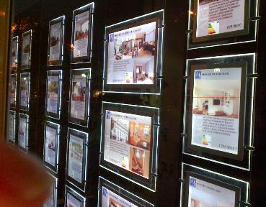
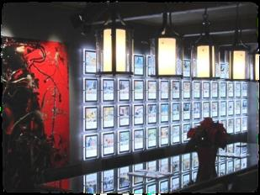
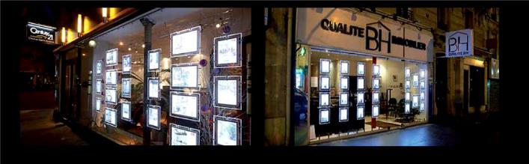
Suspended
Lit Frames

Slide 9


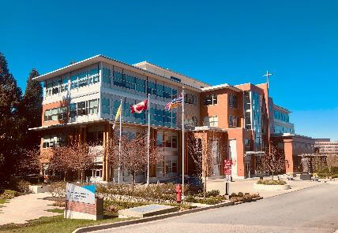
Saint John Paul II Pastoral Centre
Vancouver, BC
Consulted, coordinated and managed the design, production, and installation of all signage for JPII’s six story, Multi-use building; inclusive of Interior, Exterior, Wayfinding & Parking Garage, Traffic Calming and all sign components.
4885 Saint John Paul II Way, Vancouver, BC

Slide 10
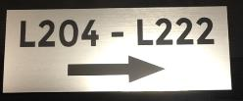
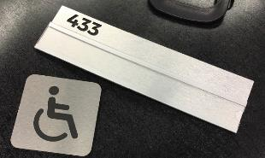
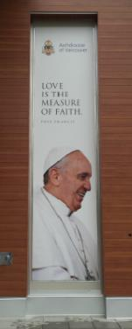
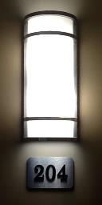
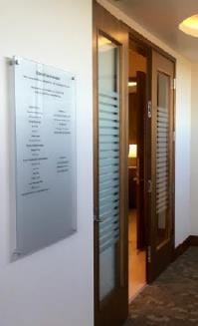
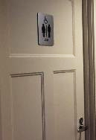
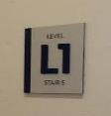
Saint John Paul II Pastoral Centre - continued
Wayfinding
Brushed Aluminum Changeable Room IDs
Acrylic Chapel Donor Board with flamed edges & stand-offs
20’H Channel mounted exterior Banner.

Slide 11

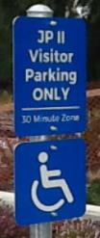

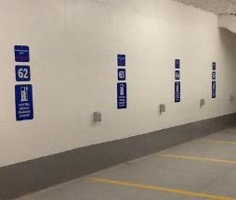

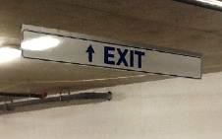
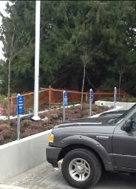
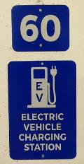
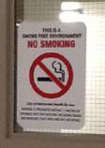

Saint John Paul II Pastoral Centre - continued
Parking Garage
3M EG Reflective with Translucent Vinyl
Height Restriction Bars
Code Signage

Slide 12


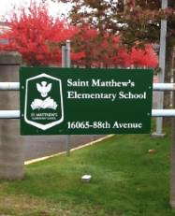
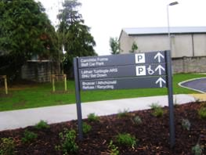
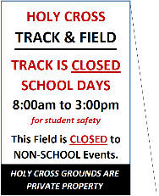





Schools
Brand Recognition
Code Signage
LEED Awareness
Environmental Awareness
Floor & Wall Graphics

Slide 13


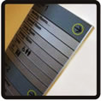

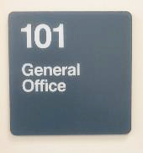
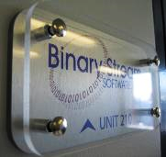

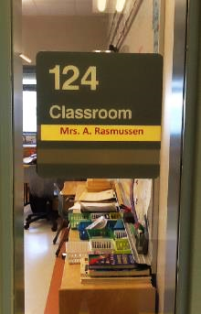



Design/Build
Brand Recognition
Code Signage
LEED Awareness
Environmental Awareness
Floor & Wall Graphics

Slide 14
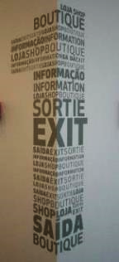
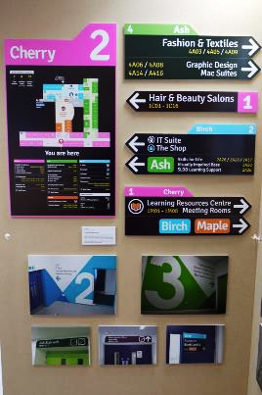


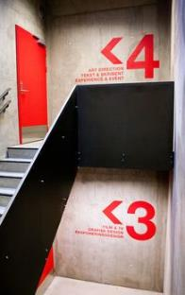
The “LOOK”
What is wanted?
What is needed?
What is required?
“Look” with the eyes of a first-time visitor brings welcomed clarity and valued comfort.
Clear Directives = Appreciated Clarity = Effective Wayfinding = Happy Visitors.

Slide 15
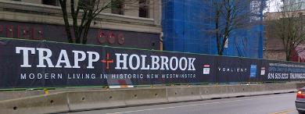
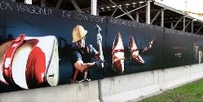
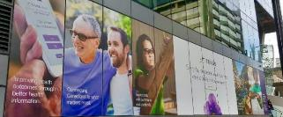
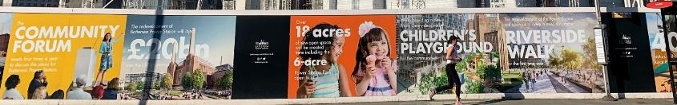
Hoarding

Slide 16



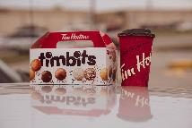


ISM - In Store Marketing
Menu Boards
Coupons
Promo Posters
Seasonal Campaigns
Tent Cards
Flyers
Glass Adhesives
Shelf Talkers
Custom Components

Slide 17
Cemetery - Wayfinding

Slide 18

WHY Wayfinding?
Have you ever been LOST? Not a nice feeling. No one likes to be lost. Yet, it happens frequently. Therein lies the power of directional signage – best known today as WAYFINDING.
Whether you require assistance in a stadium, school, store, airport, park, parking lot or cemetery - there are 5 core wayfinding principles to considered in order to assist your visitors to navigate with ease;
1. CREATE A UNIQUE PERCEPTUAL IDENTITY AT EACH LOCATION
2. USE LANDMARKS TO PROVIDE ORIENTATION CLUES
3. CREATE WELL-STRUCTURED PATHS
4. CREATE REGIONS OF DIFFERING VISUAL CHARACTER
5. DON’T GIVE THE USER TOO MANY NAVIGATIONAL CHOICES
IMAGINE – collaborating with our experts will afford you the opportunity to create a level of comfort for your valued patrons to keep them content and coming back …frequently. YES - WE CAN HELP!

Slide 19

Many Thanks…
Time is the most precious commodity within our fast-paced world today. Please know that your time, attention and kind consideration is greatly appreciated by all of us at Advantage r&n. It is our greatest pleasure to share a glimpse of our ever-expanding offerings within our Graphics, Wayfinding, ISM, Large Format, General Signage, Traffic applications and more. We look forward to;
earning your business
providing you with excellent products
surrounding and fully supporting them with exceptional customer service and care in the months and years to come.
We do remain… at your service!
Raymond@advantagern.ca or Nannette@advantagern.ca

